Slide 1

CAPSTONE PROJECT
NORTHWIND TRADERS SALES ANALYTICS
BY
SRIDEEP SARKAR

Slide 2
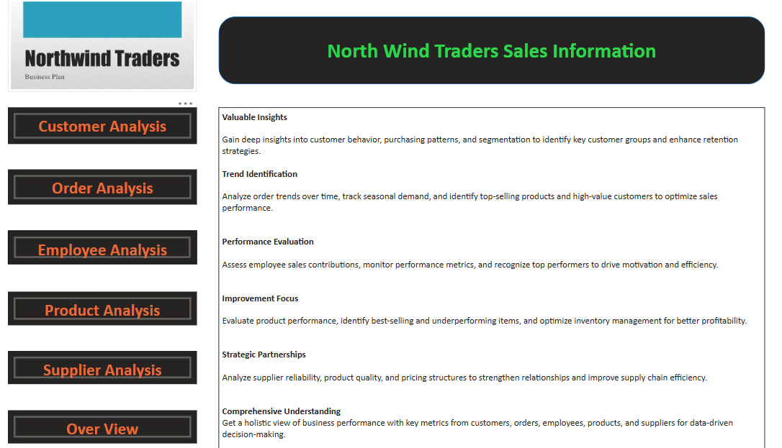

Slide 3
Objective:
This Power BI report empowers Northwind Traders with an interactive dashboard for data-driven decision-making. By analyzing sales trends, customer behavior, inventory, and employee performance, it helps optimize operations, enhance retention, and boost profitability. With real-time and historical data, it supports strategic planning and ensures a competitive edge in the wholesale market.
Analysis Scope:
This report analyzes Northwind data across customers, employees, orders, products, suppliers, and shippers. Using SQL and Power BI, it explores customer segmentation, sales trends, inventory, and employee performance. Various visualizations, including heatmaps, bar and line charts, reveal key patterns. Interactive filters and drill-downs enhance data exploration for informed decision-making.
Goal:
This project aims to create a Power BI dashboard that provides key insights into Northwind Traders' sales, customer behavior, and workforce efficiency. By leveraging interactive visuals, it helps optimize revenue, streamline supply chain management, and track performance metrics. Ultimately, it serves as a strategic tool for data-driven decision-making.

Slide 4
Insights & Recommendations:
The analysis highlights key trends in sales, customer behavior, and workforce efficiency. Findings may reveal top-performing products, key customer segments, and seasonal sales patterns. Recommendations include optimizing inventory, improving engagement strategies, and enhancing employee training. These insights help Northwind Traders drive profitability and efficiency through data-driven decisions.
Report & Presentation:
The final report will present key insights, visualizations, and recommendations in a clear, structured format. A concise presentation will highlight trends, data-driven conclusions, and actionable strategies using charts and infographics to enhance understanding, ensuring effective communication for decision-makers.
Power BI Dashboard:
The dashboard provides interactive, real-time insights into sales, orders, customers, and employee performance. With dynamic filters for deeper analysis, it simplifies complex data, supporting strategic planning and quick decision-making with a comprehensive business overview.

Slide 5
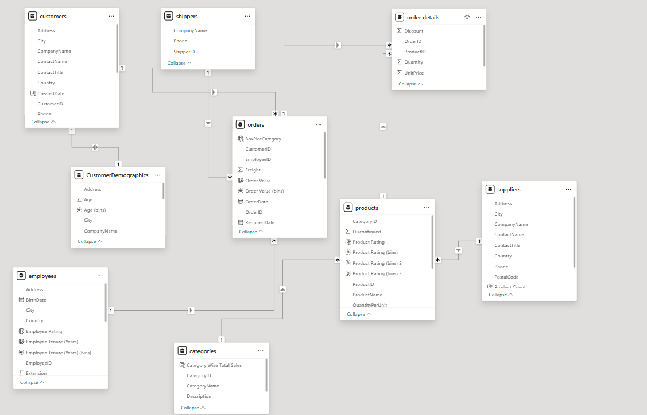
ER DIAGRAM

Slide 6
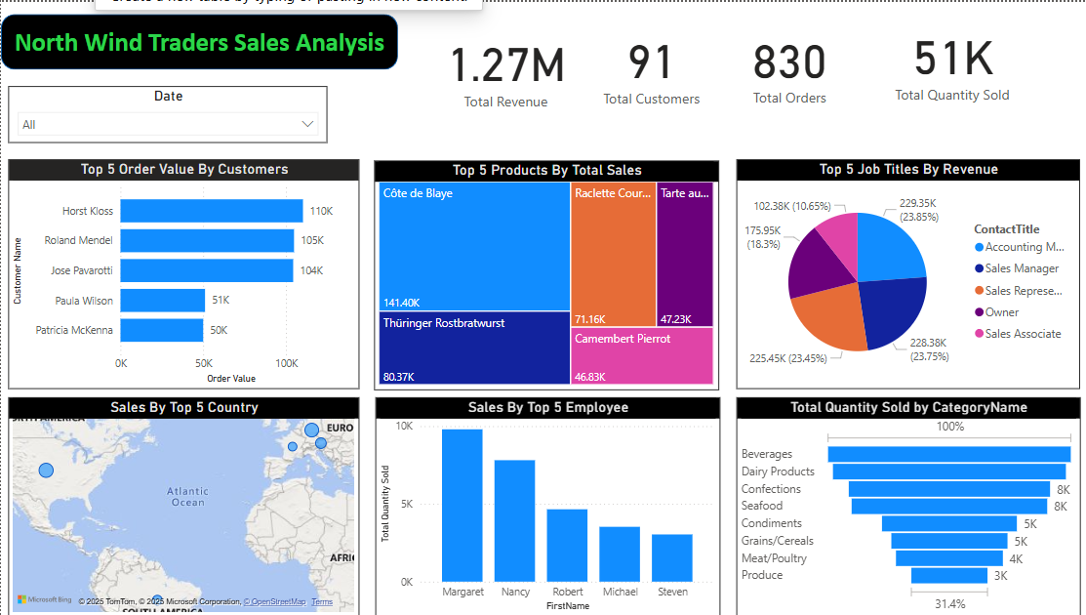
POWERBI PROBLEM STATEMENTS Overview

Slide 7
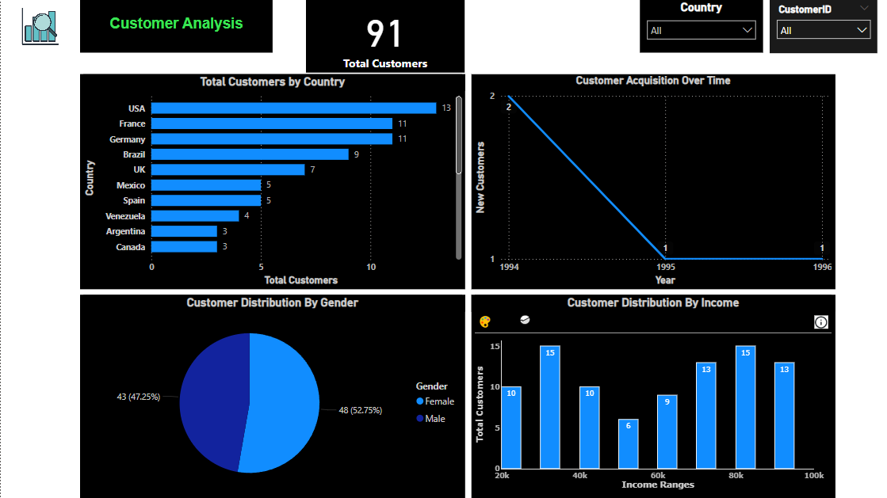

Slide 8
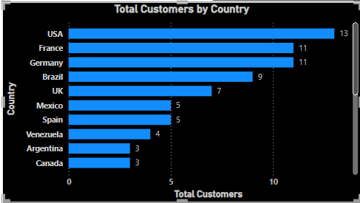
How does customer distribution vary across different country?
The chart highlights the USA as the leading market with 13 customers, followed by France and Germany (11 each). Brazil and the UK also have notable customer presence, while other countries have lower counts. This suggests a concentration in a few key markets, presenting opportunities to expand customer engagement in underrepresented regions..
The customer base is concentrated in a few key markets, with the USA, France, and Germany leading. This indicates strong engagement in these regions but also highlights potential for growth in countries with lower customer representation. Expanding efforts in these areas could enhance market reach and business opportunities.

Slide 9
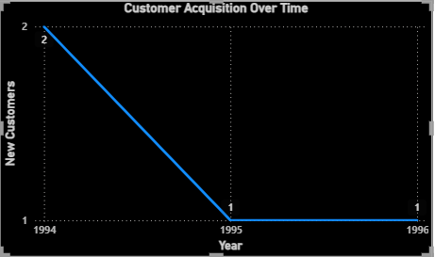
What is the trend in customer acquisition over time?
The customer base is concentrated in a few key markets, with the USA, France, and Germany leading. This indicates strong engagement in these regions but also highlights potential for growth in countries with lower customer representation. Expanding efforts in these areas could enhance market reach and business opportunities.

Slide 10
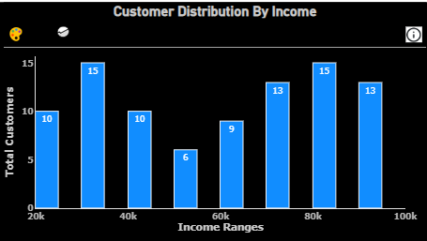
Can we visualize the distribution of customer demographic such income?
The 40k and 80k income groups have the highest customer engagement (15 each), indicating strong market appeal. The 60k range has the lowest (6 customers), suggesting a potential gap to address. Higher-income groups (80k–100k) also show significant presence, highlighting a diverse customer base. Businesses should focus on the 40k and 80k segments while exploring strategies to attract more customers from the 60k range, such as adjusting pricing or targeted promotions.

Slide 11
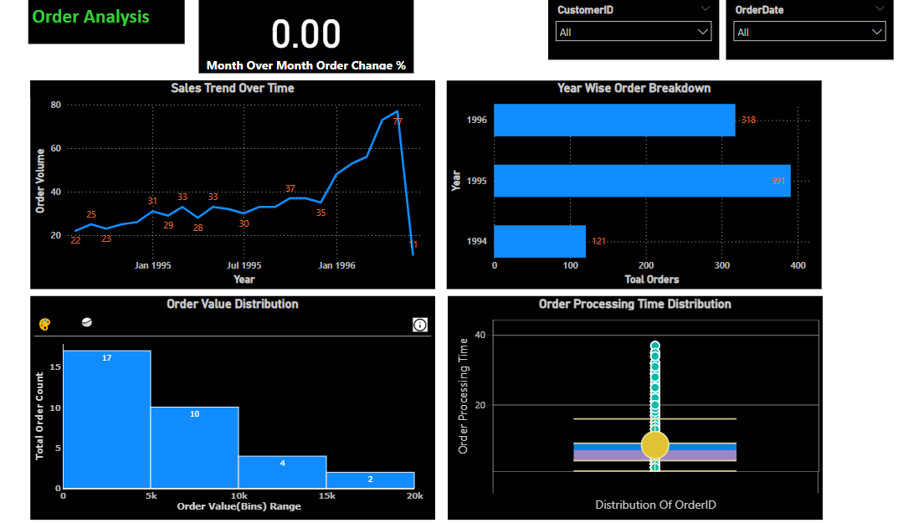

Slide 12
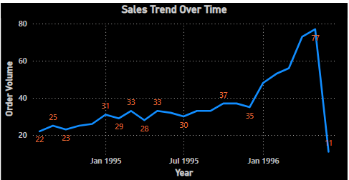
How does order volume change over time?
The sales trend over time shows a steady increase in order volume from early 1995 to late 1996, indicating business growth and increasing demand. The order volume fluctuated slightly in 1995, but a significant upward trend started in 1996, reaching a peak of 77 orders. However, there is a sharp decline at the end, dropping to 11 orders, which could indicate seasonal fluctuations, market changes, or operational challenges. Analyzing the reason for this sudden drop could help in developing strategies to sustain sales momentum.

Slide 13
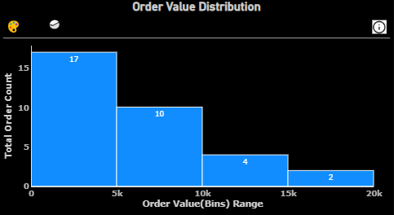
What is the distribution of order values?
The majority of orders fall within the lower value range, with 17 orders below 5k and 10 orders between 5k-10k, indicating that most customers prefer smaller transactions. As the order value increases, the frequency declines significantly, with only 4 orders in the 10k-15k range and 2 in the 15k-20k range. This trend suggests a need to analyze why high-value orders are fewer and explore strategies like discounts, bulk purchase incentives, or premium product offerings to encourage larger transactions.

Slide 14
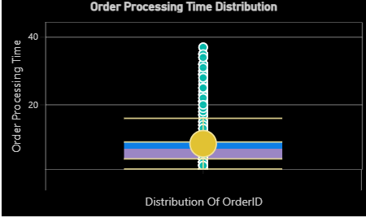
Can we visualize the average order processing time distribution?
This box plot represents the distribution of order processing times, highlighting outliers that significantly exceed the normal range. The majority of orders have processing times concentrated within a narrow range, as indicated by the box. However, there are several extreme outliers extending beyond 40 units, suggesting that some orders take considerably longer to process. This could indicate operational inefficiencies, supply chain delays, or exceptions in order handling. Further investigation into the causes of these outliers could help optimize processing times and improve overall efficiency.

Slide 15
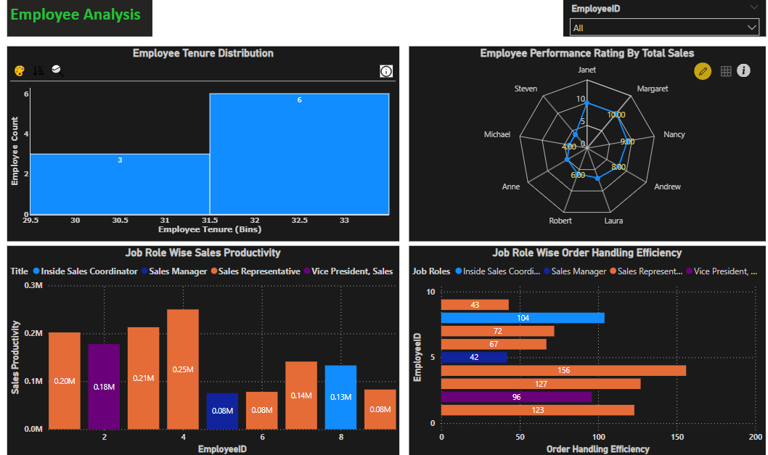

Slide 16
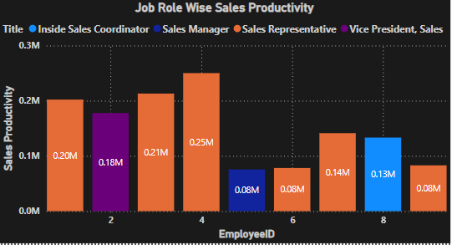
How does employee productivity vary across different job roles?
Summary of Sales Productivity Chart:
Sales Representatives lead in productivity (0.20M–0.25M).
Vice President of Sales has 0.18M productivity.
Inside Sales Coordinators have lower productivity (0.08M–0.13M).
Employee ID 4 is the top performer (0.25M), while IDs 6 & 8 have the lowest (0.08M).
Recommendation: Improve productivity in lower-performing roles.

Slide 17
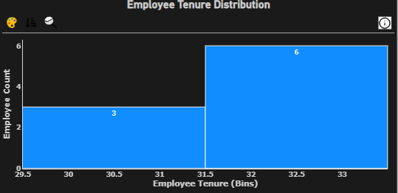
What is the distribution of employee tenure?
The histogram illustrates the distribution of employee tenure, showcasing two bins representing different tenure ranges. The x-axis spans approximately 29.5 to 33.5 years, while the y-axis denotes the employee count. The first bin (29.5–31.5 years) includes 3 employees, whereas the second bin (31.5–33.5 years) contains 6 employees. The chart features a dark background with blue bars and white text, enhancing readability. Overall, the visualization highlights that more employees have longer tenures within the given range.

Slide 18
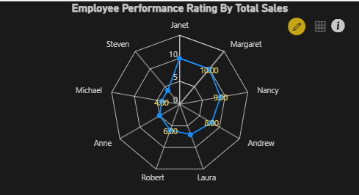
Can we visualize employee performance ratings?
The radar chart visualizes Employee Performance Rating by Total Sales, comparing multiple employees' performance. Each axis represents an employee, with ratings plotted on a scale from 0 to 10. Employees like Janet and Margaret have the highest ratings at 10, while others, such as Michael and Anne, have lower ratings around 4-6. The dark background, blue data points, and yellow numeric labels enhance readability. This visualization helps identify top performers and areas where improvement is needed.

Slide 19
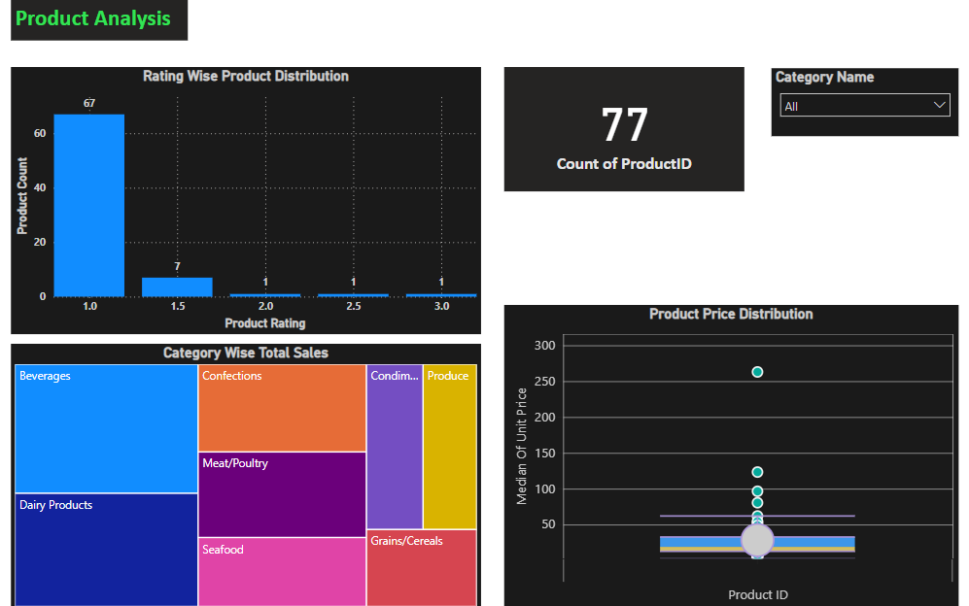

Slide 20
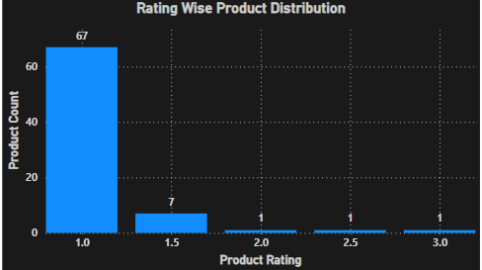
What is the distribution of product ratings?
The radar chart visualizes Employee Performance Rating by Total Sales, comparing multiple employees' performance. Each axis represents an employee, with ratings plotted on a scale from 0 to 10. Employees like Janet and Margaret have the highest ratings at 10, while others, such as Michael and Anne, have lower ratings around 4-6. The dark background, blue data points, and yellow numeric labels enhance readability. This visualization helps identify top performers and areas where improvement is needed.

Slide 21
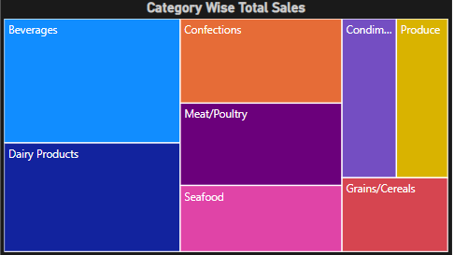
How does the sales volume vary across different product categories?
This treemap visualizes Category-Wise Total Sales, with each rectangle representing a product category. The size of each section indicates the proportion of total sales contributed by that category. Beverages and Dairy Products appear to have the largest sales share, while Condiments, Produce, and Grains/Cereals contribute relatively less. The use of distinct colors enhances readability, making it easy to compare sales distribution across categories.

Slide 22
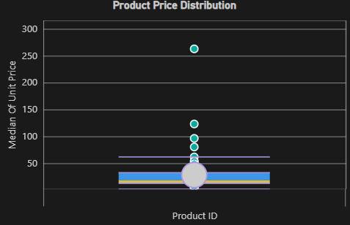
Can we visualize the pricing distribution of products using a box plot
This Product Price Distribution box plot visualizes the spread of unit prices across different products. The central box represents the interquartile range (IQR), while the horizontal line inside it indicates the median price. The outliers, shown as scattered points above the main box, suggest that some products have significantly higher prices. The majority of product prices are concentrated within a lower range, with a few extreme values reaching above 250. This visualization helps identify pricing trends and potential anomalies.

Slide 23
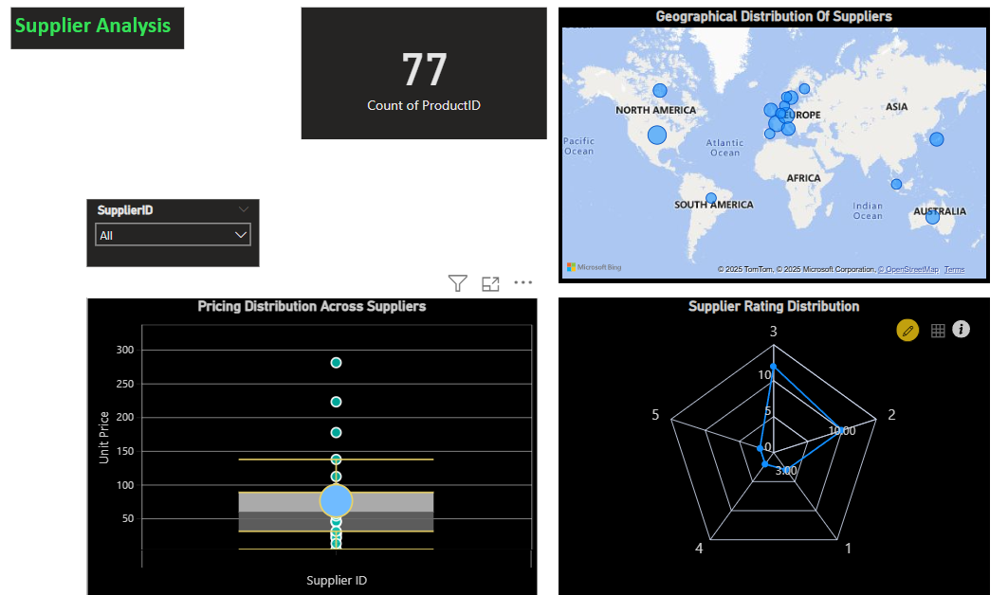

Slide 24
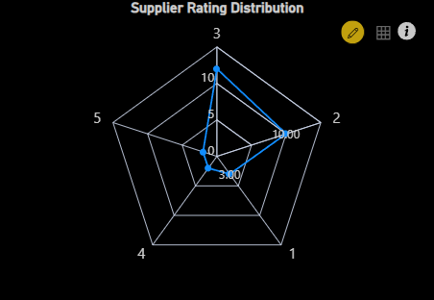
What is the distribution of supplier ratings?
This Supplier Rating Distribution radar chart visualizes ratings across five different supplier categories. The chart highlights variations in performance, with some suppliers scoring as high as 10 while others have lower ratings around 3. The structure helps compare multiple suppliers at a glance, identifying top performers and areas needing improvement.

Slide 25
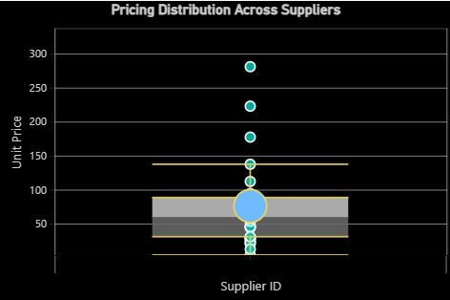
How does the pricing structure vary across different suppliers
This Pricing Distribution Across Suppliers box plot visualizes the variation in unit prices among different suppliers. The shaded box represents the interquartile range (IQR), while the whiskers indicate the overall spread of prices. Outliers are shown as points beyond the whiskers, highlighting extreme price variations. The plot helps identify pricing trends, consistency, and potential anomalies across suppliers.

Slide 26
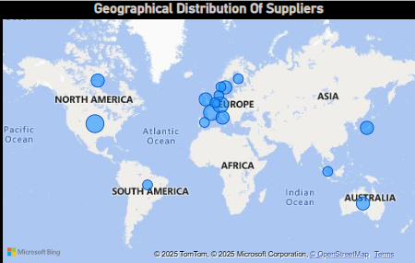
Can we visualize the geographical distribution of suppliers using a map or bubble chart?
This Geographical Distribution of Suppliers map visualizes supplier locations worldwide. The size of each blue bubble represents the concentration of suppliers in a specific region. Europe appears to have the highest number of suppliers, followed by North America and Australia, with fewer in Asia, South America, and Africa. This visualization helps in understanding the global spread of suppliers and identifying key sourcing regions.

Slide 27
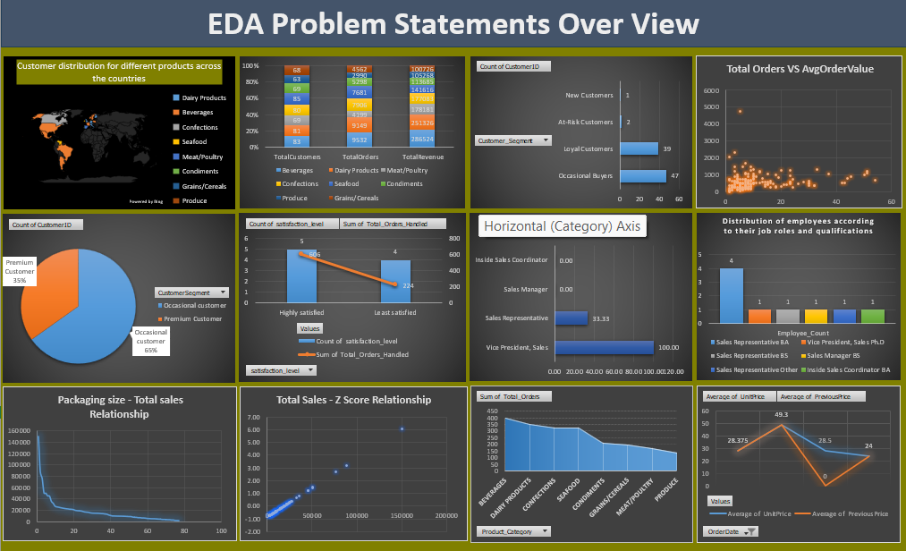

Slide 28
What are the key factors influencing customer retention or loyalty based on the dataset?
This Total Orders and Discount bar chart compares the total number of orders and the total discount given for different categories or suppliers (represented by labels on the x-axis). The taller bars indicate higher order volumes, while the smaller bars show the corresponding discounts. The chart highlights variations in sales activity and discount distribution across different entities.

Slide 29
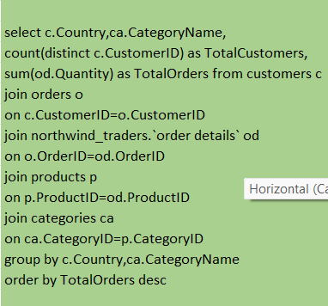
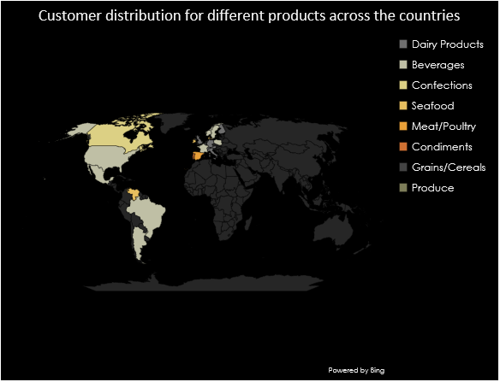
How do customer preferences vary based on their location or demographics?
This Customer Distribution for Different Products Across Countries map visualizes how different product categories (e.g., Dairy, Beverages, Meat/Poultry, etc.) are distributed across various regions. Different colors represent distinct product categories, highlighting the concentration of customer demand in specific areas.

Slide 30
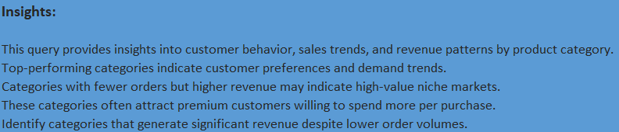
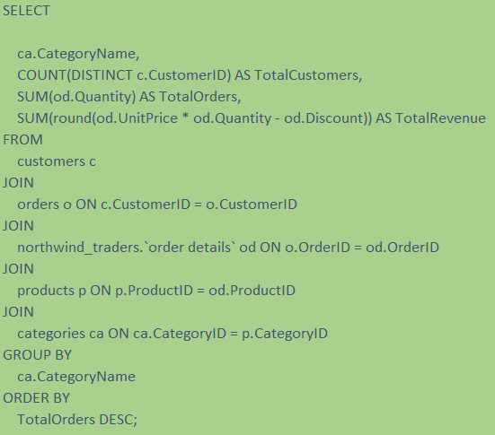
Are there any interesting patterns or clusters in customer behavior that can be visualized to identify potential market segments?

Slide 31
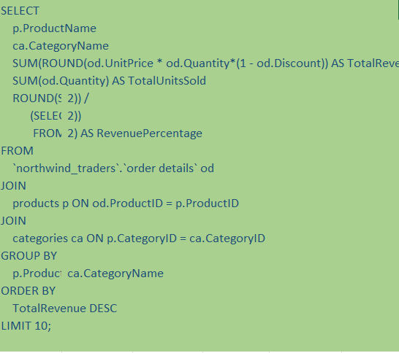
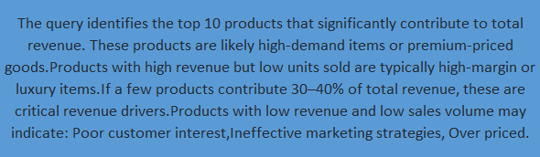
Are there any specific product categories or SKUs that contribute significantly to order revenue?
.

Slide 32
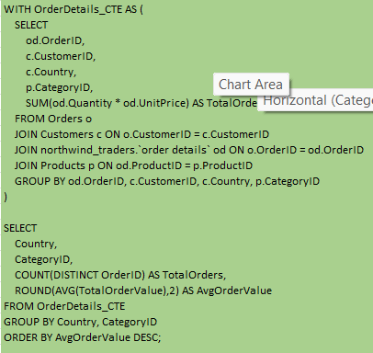
Are there any correlations between order size and customer demographics or product categories?

Slide 33
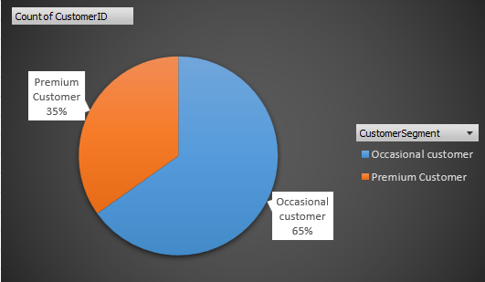
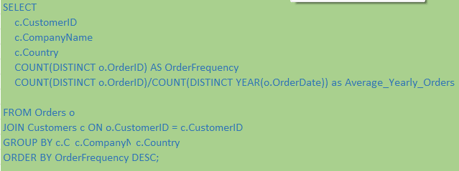
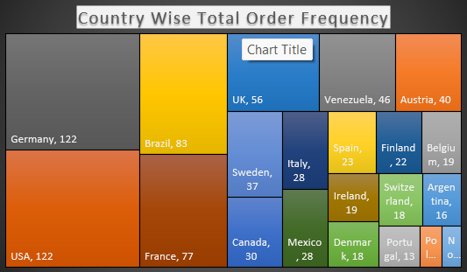
How does order frequency vary across different customer segments?
This pie chart shows customer segmentation: 65% Occasional Customers and 35% Premium Customers, indicating that most customers buy occasionally, while a smaller segment is premium.

Slide 34
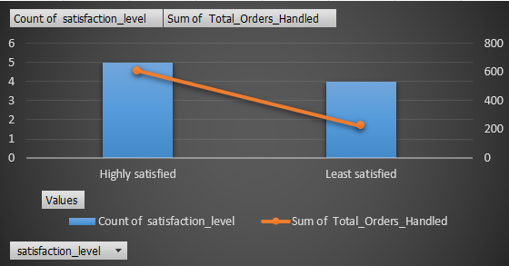
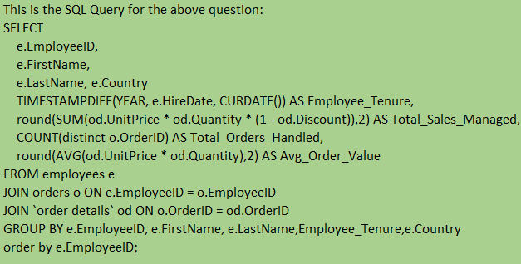
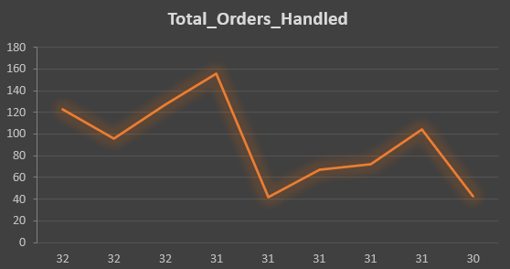
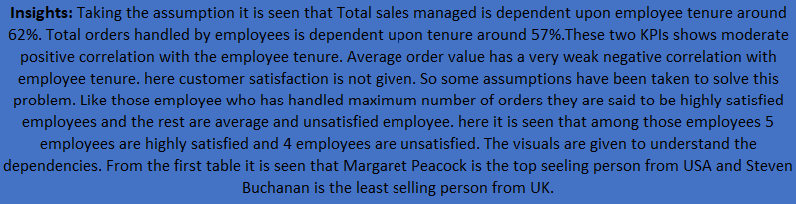
Are there any correlations between employee satisfaction levels and key performance indicators?

Slide 35
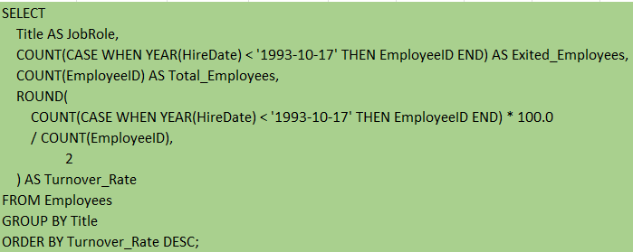
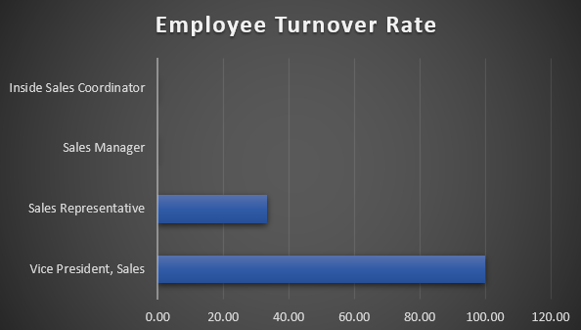
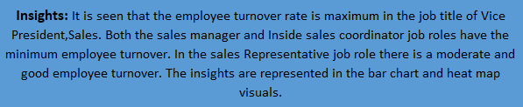
How does employee turnover vary across different departments or job roles?

Slide 36
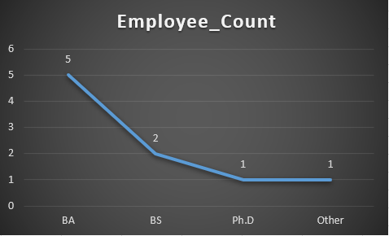
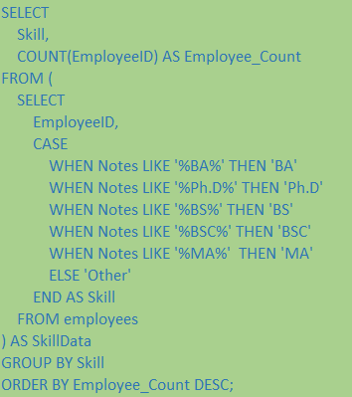
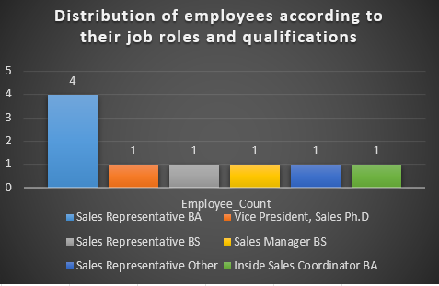
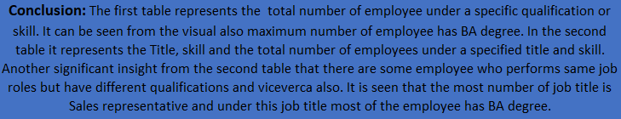
Can we identify any patterns or clusters in employee skill sets or qualifications through visualizations?

Slide 37
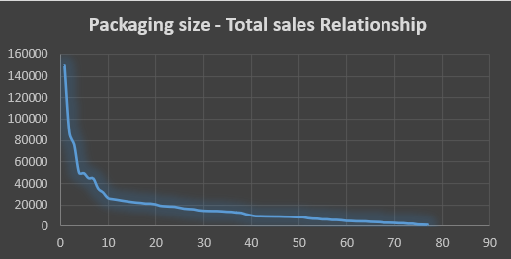
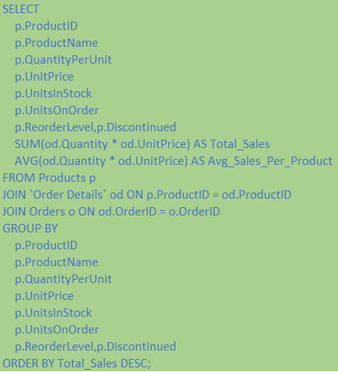
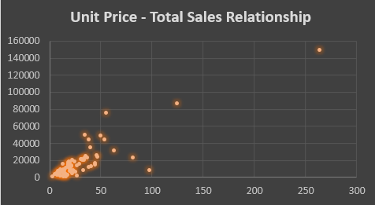
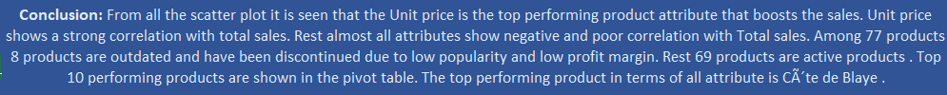
Are there any correlations between product attributes and sales performance?

Slide 38
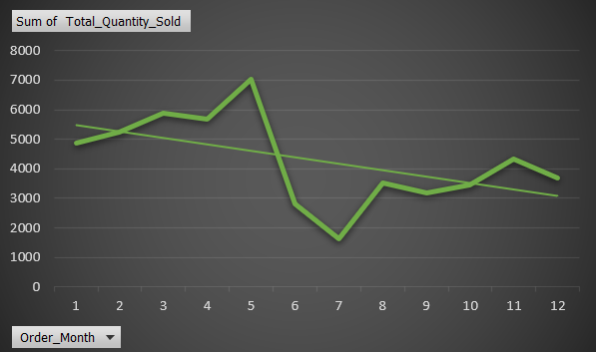


How does product demand fluctuate over different seasons or months?

Slide 39





Can we identify any outliers or anomalies in product performance or sales using visualizations?

Slide 40




Are there any correlations between supplier attributes (e.g., location, size, industry) and performance metrics (e.g., on-time delivery, product quality)?

Slide 41




How does supplier performance vary across different product categories or departments?

Slide 42






Can we identify any trends or patterns in supplier costs or pricing structures through visualizations?

Slide 43
Thank you

